Slide 1
Introduction to Software Defined Radio
Sniffing the Airwaves

Slide 2
Introduction
This is a follow up from last years presentation on 433Mhz and IoT devices. I was showing how to get the codes sent from devices and it piqued some people's interest in software defined radio.
Today any person can purchase a $25 device and with a laptop begin exploring the addicting hobby of software defined radio, so I will go through what it is and getting started yourself on sniffing the airwaves. Then we will have fun with some examples and eavesdrop on some rf devices.

Slide 3
Whoami
My name is Larry Apolonio
I work for the Port of Seattle as a Linux Server Engineer
My focus strengths are Linux and Networking.
I do this maker stuff for fun and I like to share what I have discovered.

Slide 4
Disclaimer
I am not a radio guy, I don’t even have an amateur radio license.
I just eavesdrop, and according to people who I know that do radio for a living, listening on unencrypted radios is legal.

Slide 5
Past/Present/Future
Past – I year ago people showed interest in SDR when I sniffed 433mhz devices
Present – I did a bit more with SDR, listen in on audio, and understand some protocols better.
Future – Sniff 433mhz devices directly to Linux computer rather than through a microcontroller.

Slide 6
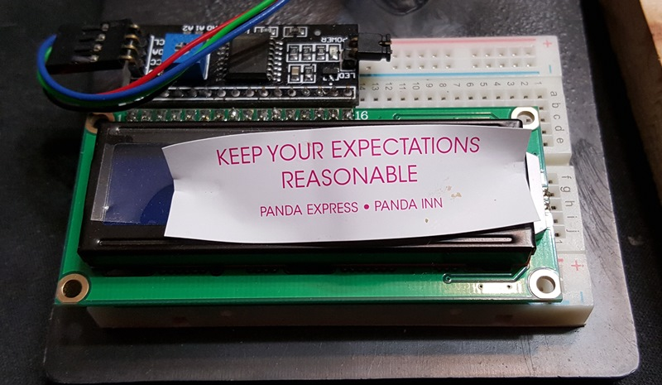
As Always
Notes:
I have not done a class this size before, usual size is 10 to 15, ideal size is 5

Slide 7
Examples of SDR
Listening to FM Radio
Listening to FRS and old school Walkie Talkie
Watching Digital signals from devices
Watching Digital devices from airplanes

Slide 8
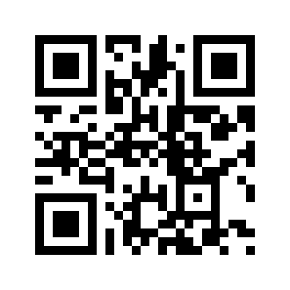
FM Radio Example
https://youtu.be/nbMTqu42IAs

Slide 9
Walkie Talkie Example

Slide 10
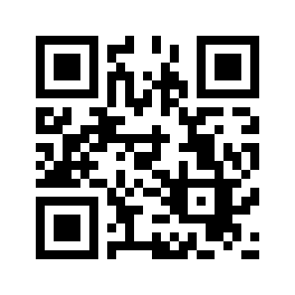
433 Mhz Devices
https://youtu.be/ZiLi0l79ZW4

Slide 11
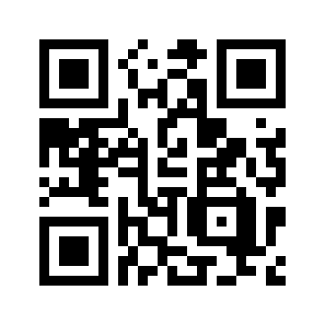
Airplanes ADS-B
https://youtu.be/eSiUfT0k_bc

Slide 12
Other things you can do
Police Scanner
Random Number Generator
ACARS
Pager info
Radio Astronomy
NOAA Satellite Images

Slide 13
Installation
Basics is simple
Yum install rtl_sdr
Modify udev to allow users to access device
Modify modprobe to blacklist dvb_usb_rtl28xxu

Slide 14
Limitation
Cant Listen to AM radio
Antenna matters
Location Matters

Slide 15
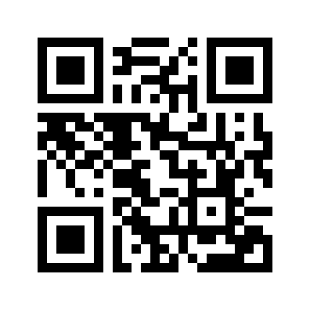
Installation
https://www.apolonio.com/presentations

Slide 16
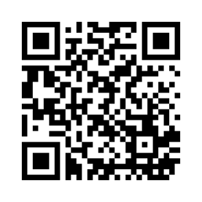
Presentation Download
https://www.apolonio.com/presentations

Slide 17
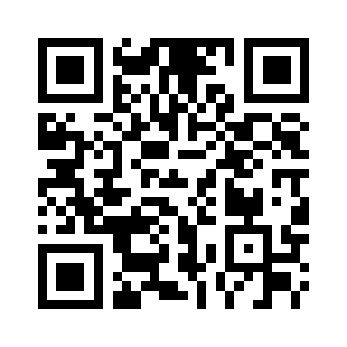
Meetup
https://www.meetup.com/Tukwila-Maker-User-Group/

Slide 18
My Resources
https://ranous.wordpress.com/rtl-sdr4linux
https://github.com/cjcliffe/CubicSDR/wiki/Build-Linux

Slide 19
Q & A

Slide 20
Contact Info
Larry Apolonio
larry@apolonio.tech

