Slide 1
LinuxFest NorthWest 2018
Message In A Bottle
Arduino, ESP8266 and 433 Mhz Devices

Slide 2
Arduino, ESP8266 and 433 Mhz Devices
Presented by
Larry Apolonio
Notes:
Click to add notes

Slide 3
Introduction
Welcome to LinuxFest 2018.
Presentation is on Arduino, ESP8266, 433Mhz devices, and MQTT
Notes:
How presentation will benefit audience: Adult learners are more interested in a subject if they know how or why it is important to them.
Presenter’s level of expertise in the subject: Briefly state your credentials in this area, or explain why participants should listen to you.

Slide 4
Whoami
My name is Larry Apolonio
Did several presentations
Day job I manage Linux Server.
I do this maker stuff for fun and I like to share what I have discovered.
I don’t do this professionally

Slide 5
Presentation Outline
Topic 1: Arduino
Programming Environment
Topic 2: ESP8266
Microcontroller that connects to Wifi Network
Topic 3: 433 Mhz Devices
Inexpensive Wireless Devices
Topic 4: MQTT Protocol
Simple protocol for device communication
Notes:
Lesson descriptions should be brief.

Slide 6
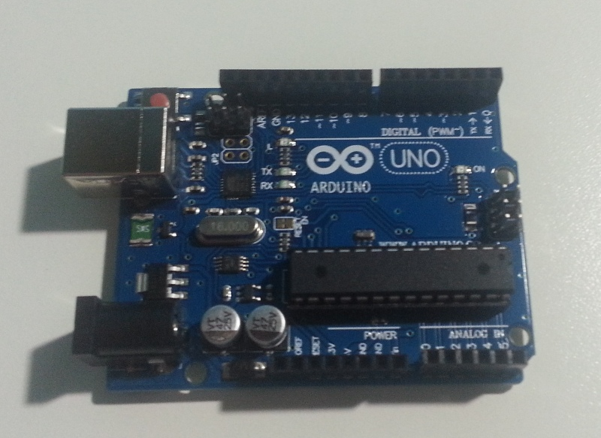
Topic 1: Arduino
What is It
Definition from the web site – “Arduino is an open-source electronics platform based on easy-to-use hardware and software. It's intended for anyone making interactive projects.”

Slide 7
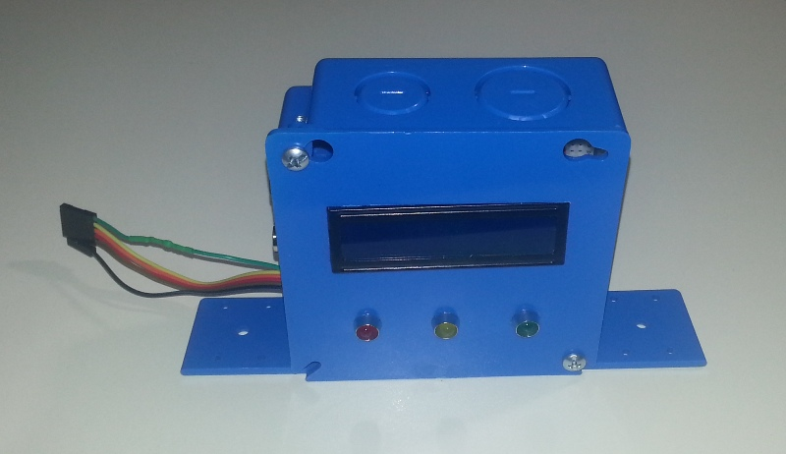
Topic 1: What it is to me
My definition – “A cool kit that enables you to build your own electronics easily”

Slide 8
Topic 1: Show
Show example of Arudino IDE in Action

Slide 9
Topic 1: Version
Versions matter, the sketches in this presentation were based on
Arduino 1.8.5
ESP8266 2.3.0
rc-switch 2.6.2
MQTT 1.10.1
ESP8266 oled driver for SSD1306 2.0.2

Slide 10
Topic 2: ESP8266
What is It
It is a microcontroller chip used in a lot of IoT Devices
You can program it using the Arduino IDE
Comes in several types of Packaging

Slide 11
Topic 2: Sample Products
ESP8266 to 433Mhz Bridge

Slide 12
Topic 2: Packages
ESP-01
Node MCU
Wemos D1 Mini
Arduino UNO Shield

Slide 13
Topic 2: 3.3V
The ESP8266 (as well as the Raspberry Pi) runs on 3.3V and outputs/inputs on 3.3V
Make sure you have a power supply or voltage regular that is 3.3V
Use a voltage divider, level shifter, or mosfet to communicate at 3.3V

Slide 14
Topic 3: 433 Mhz Devices
There are a lot of 433Mhz and 315Mhz Devices that can monitor and do a variety of things in your home.
The transmit or receive a code.
You may already have some.

Slide 15
Topic 3: 433 Mhz Devices
Show Sample of 433 Mhz Devices

Slide 16
Topic 3: 433 Mhz Devices
Already build, just add battery or plug in.
Low power, will last months
Insecure

Slide 17
Topic 4: MQTT
Simple protocol for device communication
Runs on a lot of things, Arduino, Raspberry Pi, Windows, mobile devices
Fast
Twitter like
Topics = Hashtag
Subscribe = Follow
Tweet = Publish

Slide 18
Lesson 4: MQTT Demonstration
Show Video of MQTT in action

Slide 19
Lesson 4: Payload
You can send different types of data
Integers
Text
Binaries (Images)
Make sure your devices can handle what you are sending
Sample codes sends strings less then 126 characters

Slide 20
Putting it all Together

Slide 21
Security Implications

Slide 22
For More Information
https://www.apolonio.com/presentations

